Slide 1
DBMS
Joins and Views

Slide 2
MySQL Joins
The JOIN clause is used to combine rows from two or more tables, based on a related column between them.

Slide 3
Types of JOINs
(INNER) JOIN: Returns only rows that have matching values in both tables
LEFT (OUTER) JOIN: Returns all rows from the left table, and only the matched rows from the right table
RIGHT (OUTER) JOIN: Returns all rows from the right table, and only the matched rows from the left table
FULL (OUTER) JOIN: Returns all rows when there is a match in either the left or right table

Slide 4
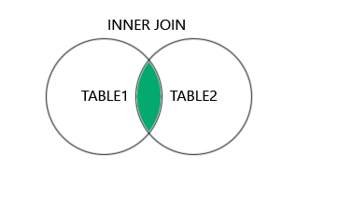
INNER JOIN
The INNER JOIN clause returns only rows that have matching values in both tables.
SELECT table1.column1, table1.column2, ..., table2.column1, ...
FROM table1
INNER JOIN table2
ON table1.condition_column = table2.condition_column;

Slide 5
Products
Categories

Slide 6
SELECT Products.ProductID, Products.ProductName, Categories.CategoryName
FROM Products
INNER JOIN Categories ON Products.CategoryID = Categories.CategoryID;
INNER JOIN returns only rows with a match in both tables.
This means that if there is a product with no CategoryID, or with a CategoryID not present in the "Categories" table, that row will not be returned in the result.

Slide 7
CustomerID | CustomerName
1 | John
2 | Alice
3 | Rahul
4 | Maria
5 | David
ShipperID | ShipperName
1 | Speedy Express
2 | Fast Delivery
3 | DHL
OrderID | CustomerID | ShipperID
101 | 1 | 2
102 | 2 | 1
103 | 3 | 2
104 | 5 | 3

Slide 8
JOIN Multiple Tables
SELECT Orders.OrderID, Customers.CustomerName, Shippers.ShipperName
FROM Orders
INNER JOIN Customers ON Orders.CustomerID = Customers.CustomerID
INNER JOIN Shippers ON Orders.ShipperID = Shippers.ShipperID;
OrderID | CustomerName | ShipperName
101 | John | Fast Delivery
102 | Alice | Speedy Express
103 | Rahul | Fast Delivery
104 | David | DHL

Slide 9
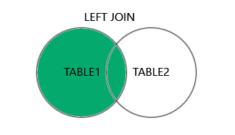
LEFT JOIN
The LEFT JOIN clause returns all rows from the left table (table1), and only the matched rows from the right table (table2).
If there is no match in the right table, the result for the columns from the right table will be NULL.

Slide 10
SELECT table1.column1, table1.column2, ..., table2.column1, ...
FROM table1
LEFT JOIN table2
ON table1.condition_column = table2.condition_column;

Slide 11
Customers
Customer ID | Customer Name | Contact Name | Address | City | Postal Code | Country
1 | Alfreds Futterkiste | Maria Anders | Obere Str. 57 | Berlin | 12209 | Germany
2 | Ana Trujillo Emparedados y helados | Ana Trujillo | Avda. de la Constitución 2222 | México D.F. | 05021 | Mexico
3 | Antonio Moreno Taquería | Antonio Moreno | Mataderos 2312 | México D.F. | 05023 | Mexico
Orders
Order ID | Customer ID | Employee ID | Order Date | Shipper ID
10308 | 2 | 7 | 1996-09-18 | 3
10309 | 37 | 3 | 1996-09-19 | 1
10310 | 77 | 8 | 1996-09-20 | 2

Slide 12
SELECT Customers.CustomerName, Orders.OrderID
FROM Customers
LEFT JOIN Orders ON Customers.CustomerID = Orders.CustomerID
ORDER BY Customers.CustomerName;
Customer Name | Order ID
Alfreds Futterkiste | NULL
Ana Trujillo Emparedados y helados | 10308
Antonio Moreno Taquería | NULL

Slide 13
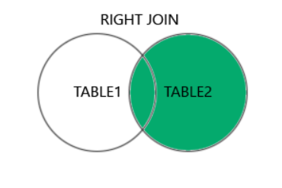
RIGHT JOIN
The RIGHT JOIN returns all rows from the right table (table2), and only the matched rows from the left table (table1).
If there is no match in the left table, the result for the columns from the left table will be NULL.
The RIGHT JOIN and RIGHT OUTER JOIN keywords are equal - the OUTER keyword is optional.

Slide 14
SELECT column_name(s)
FROM table1
RIGHT JOIN table2
ON table1.column_name = table2.column_name;

Slide 15
Orders
Employees
Order ID | Customer ID | Employee ID | Order Date | Shipper ID
10308 | 2 | 7 | 1996-09-18 | 3
10309 | 37 | 3 | 1996-09-19 | 1
10310 | 77 | 8 | 1996-09-20 | 2
Employee ID | LastName | FirstName | Birth Date | Photo
1 | Davolio | Nancy | 1968-12-08 | EmpID1.pic
2 | Fuller | Andrew | 1952-02-19 | EmpID2.pic
3 | Leverling | Janet | 1963-08-30 | EmpID3.pic

Slide 16
SELECT Orders.OrderID, Employees.LastName, Employees.FirstName
FROM Orders
RIGHT JOIN Employees ON Orders.EmployeeID = Employees.EmployeeID
ORDER BY Orders.OrderID;
Order ID | Last Name | First Name
NULL | Davolio | Nancy
NULL | Fuller | Andrew
10309 | Leverling | Janet

Slide 17
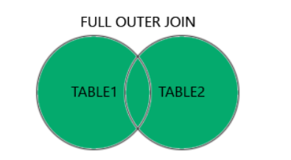
FULL JOIN
The FULL JOIN returns all rows when there is a match in either the left or right table.
If a row in the left table has no match in the right table, the result set includes the left row's data and NULL values for all columns of the right table.
The FULL JOIN and FULL OUTER JOIN keywords are equal - the OUTER keyword is optional.

Slide 18
SELECT column_name(s)
FROM table1
FULL JOIN table2
ON table1.column_name = table2.column_name
WHERE condition;

Slide 19
CustomerID | CustomerName | ContactName | Address | City | PostalCode | Country
1 | Alfreds Futterkiste | Maria Anders | Obere Str. 57 | Berlin | 12209 | Germany
2 | Ana Trujillo Emparedados y helados | Ana Trujillo | Avda. de la Constitución 2222 | México D.F. | 05021 | Mexico
3 | Antonio Moreno Taquería | Antonio Moreno | Mataderos 2312 | México D.F. | 05023 | Mexico
OrderID | CustomerID | EmployeeID | OrderDate | ShipperID
10308 | 2 | 7 | 1996-09-18 | 3
10309 | 37 | 3 | 1996-09-19 | 1
10310 | 77 | 8 | 1996-09-20 | 2

Slide 20
SELECT Customers.CustomerName, Orders.OrderID
FROM Customers
FULL JOIN Orders
ON Customers.CustomerID = Orders.CustomerID;
CustomerName | OrderID
Null | 10309
Null | 10310
Alfreds Futterkiste | Null
Ana Trujillo Emparedados y helados | 10308
Antonio Moreno Taquería | Null

Slide 21
FULL JOIN returns all matching records from both tables whether the other table matches or not.
So, if there are rows in "Customers" that do not have matches in "Orders", or if there are rows in "Orders" that do not have matches in "Customers", those rows will be listed as well.

Slide 22
SQL Views
An SQL view is a virtual table based on the result-set of an SQL statement.
An SQL view contains rows and columns, just like a real table.
The fields in the view are fields from one or more real tables in the database.
A view is created with the CREATE VIEW statement.
A view always shows real-time data! The database engine only stores the view's definition (the SELECT statement), not a copy of the data.

Slide 23
CREATE VIEW Syntax
CREATE VIEW view_name AS
SELECT column1, column2, ...
FROM table_name
WHERE condition;
CREATE VIEW [Brazil Customers] AS
SELECT CustomerName, ContactName
FROM Customers
WHERE Country = 'Brazil’;
SELECT * FROM [Brazil Customers];

Slide 24
CREATE VIEW [Products Above Average Price] AS
SELECT ProductName, Price
FROM Products
WHERE Price > (SELECT AVG(Price) FROM Products);

Slide 25
ALTER VIEW Statement
ALTER VIEW view_name AS
SELECT column1, column2, ...
FROM table_name
WHERE condition;
ALTER VIEW [Brazil Customers] AS
SELECT CustomerName, ContactName, City
FROM Customers
WHERE Country = 'Brazil';

Slide 26
CREATE OR REPLACE VIEW Syntax
CREATE OR REPLACE VIEW view_name AS
SELECT column1, column2, ...
FROM table_name
WHERE condition;
CREATE OR REPLACE VIEW [Brazil Customers] AS
SELECT CustomerName, ContactName, City
FROM Customers
WHERE Country = 'Brazil';

Slide 27
DROP VIEW
DROP VIEW view_name;

